Slide 1
Neural Semiconductor Limited
Experience at NSL
Presented By: Rudra Sarkar
Trainee Software Engineer
Neural Semiconductor Limited

Slide 2
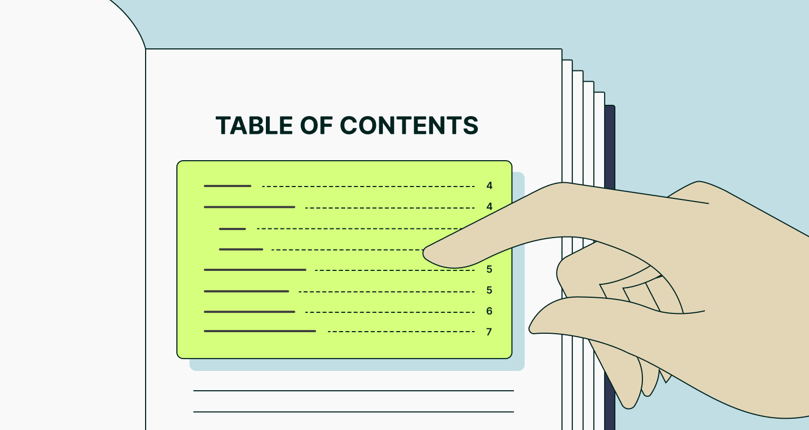
Presentation Outline:
Learned Topics
Project Contributions
Future Prospects
Training Experience
PRESENTATION OUTLINE

Slide 3
01. Learned Topics
Clean Coding:
“Clean code always looks like it was written by someone who cares.”
~ Robert C. Martin
Clean Code Meaningful Names Functions Commenting Rules
SOLID Principle:
“5” Design principles given us by Uncle Bob (Robert C. Martin)
S = Single Responsibility Principle O = Open/Closed Principle Principle
L = Liskov Substitution Principle I = Interface Segregation Principle
D = Dependency Inversion Principle
Notes:
Meaningful names: name should be declarative, consistent naming conventions
Functions: A function should do only one task, function should be short and simple
commenting: less commnet, avoid redundant comments
open/close ⇒ open for extension and close for modification
LSP ⇒ object of subclass can replace any superclass object and the code should do fine.
ISP ⇒ client shouldn’t forced to implement any interface. try to segment independent interface
DIP ⇒ Higher module shouldn’t dependent on lower module, higher and lower module all depend on abstraction

Slide 4
01. Learned Topics
Design Patterns
Design Patterns encourage us to create more maintainable, understandable, and flexible software.
“3” patterns I have learned in details:
Builder [Creational Design Pattern] Proxy [Structural Design Pattern]
Strategy [Behavioral Design Pattern]
Database Concepts and Best Practices
Fundamental database theories and database practices
Database Keys Database Normalization ACID property
Isolation
Atomicity
Consistency
Durability
Fig: ACID
Notes:
Builder: 5 players [ client, director, builder, concrete builder, product] complex obj cons, step by step construction, avoid multiple pram constructor
proxy: 4 players [client, proxy, subject, real-subject] lazy loading, access control, caching
Strategy: 4 players [client, context, strategy, concrete strategy] multiple algorithms, runtime selection
normalization:
1nf → eliminating repeating group
2nf → eliminating functional dependencies
3nf → eliminating transitive dependencies
Atomicity: the entire transactions takes place at once or doesn’t happen at all
consistency: the db must be consistent before and after the transaction
Isolation: multiple transactions doesn’t interfere each other
durability: the changes of the successful transaction takes effect even if there is a system failure
CAP: consistency, availability, partition tolerance
https://github.com/rds8rds/nsl_trainee_program/blob/main/documentations/SOLID%20%26%20Design%20Pattern/solid%20and%20design%20pattern.md

Slide 5
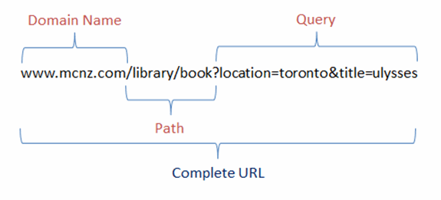
01. Learned Topics
Restful Architecture
RESTful architecture, or REST (Representational State Transfer), is a set of principles for designing networked applications.
“6” REST guiding principles:
Uniform-Interface
Client-Server Separation Stateless
Cacheability Layered System
Coding on Demand (Optional) Layered System
http status code family | Meaning
1xx | Informational response
2xx | Success
3xx | Redirection
4xx | Client error
5xx | Server error
www.nsl.com/software/emp?id=001
baseurl
path
query pram
Notes:
Uniform Interface: RESTful APIs should have a consistent interface with standard conventions, such as using HTTP verbs (GET, POST, PUT, DELETE) for actions. This uniformity simplifies interactions for clients.
Client-Server Separation: The client and server are kept separate, allowing each to evolve independently. The client is only concerned with the front-end, while the server manages data and logic, promoting flexibility and scalability.
Statelessness: Each request from a client to the server must contain all the information needed to understand and process the request. The server doesn’t store any session state about the client between requests, ensuring independence between interactions.
Cacheability: Responses from the server must define themselves as cacheable or non-cacheable. Caching improves efficiency and performance by reducing unnecessary server interactions for frequently requested resources.
Layered System: A layered architecture allows the API to include in middle functionalities (such as proxies, gateways, and load balancers) that help with scalability and security. These intermediaries should not affect the client's interactions with the API.
Code on Demand (optional): This allows servers to send executable code to the client when needed (e.g., JavaScript or applets), extending client functionality. Although optional, it can be useful for specific cases where client-side processing is necessary.
200 (Success/OK)
301 (Permanent Redirect)
302 (Temporary Redirect)
304 (Not Modified)
400 (Bad Request)
401 (Unauthorized Error)
403 (Forbidden)
404 (Not Found)
500 (Internal Server Error)
501 (Not Implemented)

Slide 6
01. Learned Topics
Dreyfus Model
Mastery
Meta Cognitive Ability
Intuition
Relevant Focus
Expert
1
Proficient
2
Competent
3
Advanced Beginner
4
Novice
5
Rules
Consider Everything
Doesn’t know what Doesn’t know
Fig: Dreyfus Model
Notes:
Dreyfus Model Skill Acquisition is a framework that describes how individuals progress through different stages of learning and mastering a skill.
Novice: Follows rules closely, limited experience.
Advanced Beginner: Recognizes patterns, applies knowledge in familiar situations.
Competent: Organizes tasks, problem-solves independently.
Proficient: Sees the "big picture," adapts based on experience.
Expert: Relies on intuition, effortlessly handles complex challenges.
A framework that describes how individuals progress through different stages of skill development.
The model identifies five stages of skill development:

Slide 7
01. Learned Topics
Spring Boot Framework
Project Setup and connect to database
Project Architecture [ model, controller & services, repositories ]
Class Relationship
One to one
One to many
Many to one
Many to many
JPA query
Creating APIs
Debugging
“2” Important Things:
Inversion of Control Dependency Injection
Notes:
project architecture:
Service, Model, Controller
AutoConfiguration

Slide 8
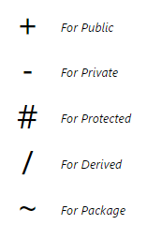
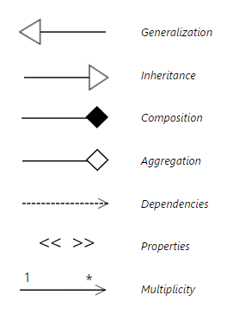
01. Learned Topics
UML Class Diagram
For the sake of clear designing of classes and their relationships Unified Model Language is important. When Learning Design pattern I also learned UML Class Diagrams
Notes:
Inheritance (Is-A): A subclass inherits from a superclass.
Association (Has-A): A class is associated with another class.
Aggregation: The associated object can exist independently.
Composition: The associated object cannot exist independently.
Dependency (Uses-A): A class uses another class to perform its functions.
Realization (Implements): A class implements an interface.
Generalization: A general concept or class is inherited by more specific
https://github.com/rds8rds/nsl_trainee_program/blob/main/documentations/OOP%20%26%20Clean%20Coding/OOP%20and%20clean%20coding.md

Slide 9
02. Project Contributions
My Workflow:
Scrum Meeting
Participate everyday scrum meeting
05
PR request to AWS Codecommit dev branch
Create PR request to merge the local branch with the dev branch
01
04
Create-> Code-> Review
Create a new branch and code as required, code as per requirements, review that with seniors for confirmation
Jira Task Board
Check jira board for assigned tasks
02
03
Discussing with team
Discussion with senior team members for further clarification
Notes:
Workflow
Jira task

Slide 10
02. Project Contributions
Project Overview
ts360 website
Testingsprint360
Simplifying test automation for Agile workflows
simply it is a product that tests any web sites, web apps, mobile applications
ts360
chrome extension
Subscription
& Auth
ts360
Mobile App Loader
API-gateway
config
preprocessor
S3 bucket
[cloud database]
Main testing
engine
High Level Project Overview
Notes:
Workflow
Testing Product

Slide 11
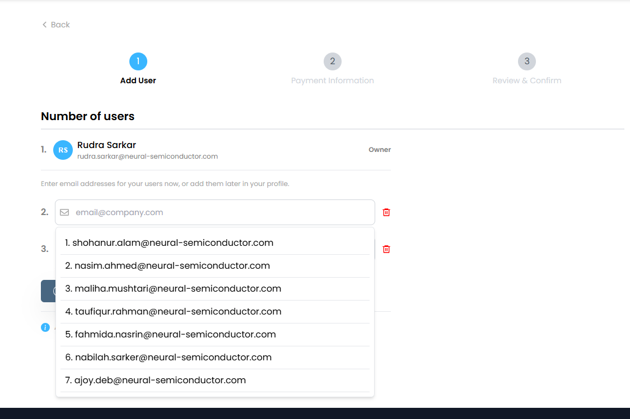
02. Project Contributions
My Contributions:
Notable contributions in CRUD APIs development:
“GET” same_organisation_user_list:
Requirements:
A user can buy a subscription for him as well as his org_users. He he needs a suggestion window. We can get organization’s
user by their org_mail suffix.
fig: front-end implementation
Notes:
Subscription-service
Adding payment method [debit/credit card] with stax
activating subscription
adding multiple multiple number of same subscription for a customer
Adding billing address to the user, and working on taxation
creating invoice for users, and adding tax info to the customer invoice
findByEmailEndingWith()

Slide 12
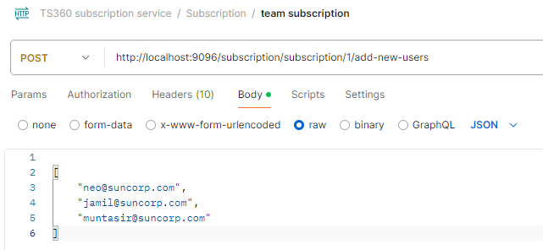
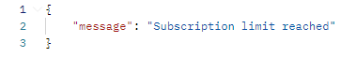
02. Project Contributions
My Contributions:
“POST” add/remove list of users in a subscription
Requirements:
A user can add a list of users to a subscription, even after the subscription is activated. Now there is some validation needs to checked, like if there is enough vacancies for the number of users in the list
fig: postman response
Notes:
Subscription-service
Adding payment method [debit/credit card] with stax
activating subscription
adding multiple multiple number of same subscription for a customer
Adding billing address to the user, and working on taxation
creating invoice for users, and adding tax info to the customer invoice

Slide 13
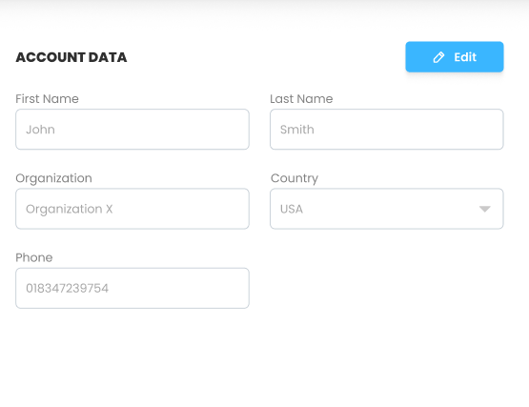
02. Project Contributions
My Contributions:
“PUT” update_user_info
Requirements:
logged in user can update user information when but she needs to authenticate with her password again if she wants to modify her user information
Learning/Challenges: PasswordEncoder, BCryptPasswordEncoder class and encode(), check() for checking password encrypted values.
Notes:
Subscription-service
Adding payment method [debit/credit card] with stax
activating subscription
adding multiple multiple number of same subscription for a customer
Adding billing address to the user, and working on taxation
creating invoice for users, and adding tax info to the customer invoice

Slide 14
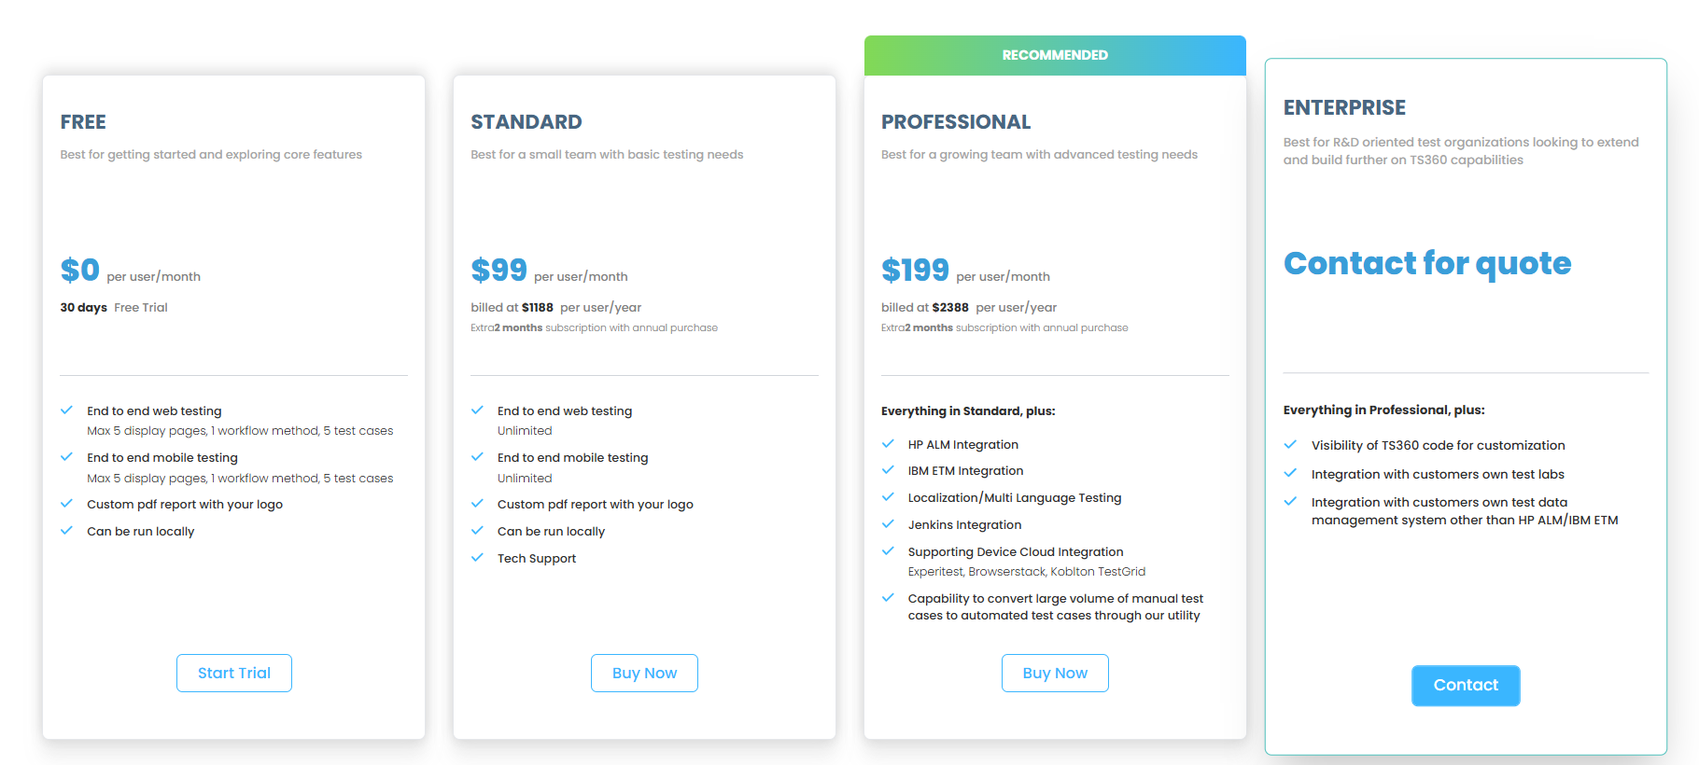
02. Project Contributions
“GET” syncing_plan_price (added feature):
Requirements:
Initially syncing_plan api which sync list of plan ids from stax database but this api needs improvement for adding plan details for each plan from the list (stax_plan_id list), I need to make a call to stax_get_ plan_details api, so that plan price could be updated. Also I have to inactive the plans which are no longer available in the stax database, or set to inactive
Learning/Challenges: RestTemplate class, exchange(), object mapping for json object.
Notes:
Subscription-service
Adding payment method [debit/credit card] with stax
activating subscription
adding multiple multiple number of same subscription for a customer
Adding billing address to the user, and working on taxation
creating invoice for users, and adding tax info to the customer invoice

Slide 15
02. Project Contributions
My Contributions:
Adding Logs to the subscription-service project
To properly keep track the chain of execution, I was assigned to logging important functions at the beginning of its execution using LoggerFactory.getLogger(this.getClass()).info()
R&D works:
Finding out the workflow to activate stax subscription
Adding Payment credit cards for the customers and successfully make payments
Generating stax invoice
FInd the workflow of adding tax to the customer bill

Slide 16
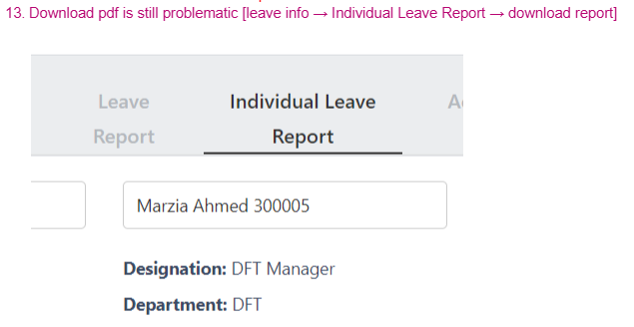
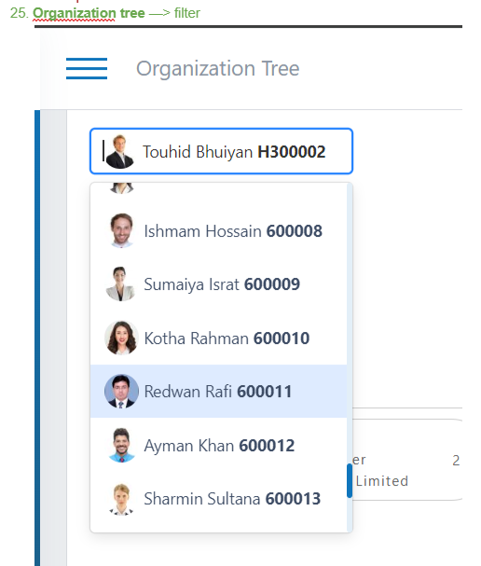
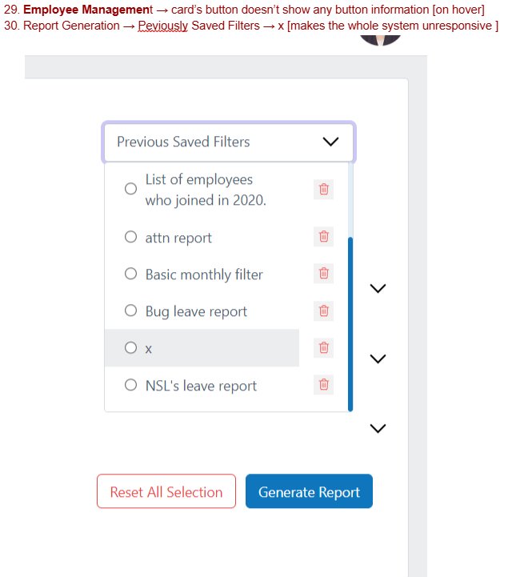
02. Project Contributions
My Contributions to other projects :
Testing on HRMS project:
Manually tested on HRMS and pointed out all employee_id [that have to be replaced with employe_visible_id], some events which led to project freezing and also gave report on how to reproduce
Figure: testing HRMS project
Notes:
Subscription-service

Slide 17
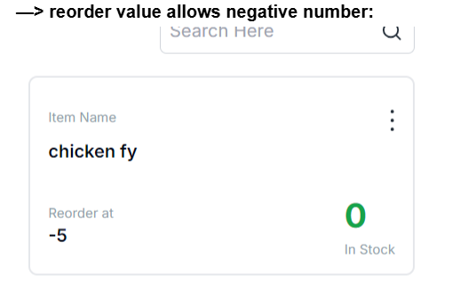
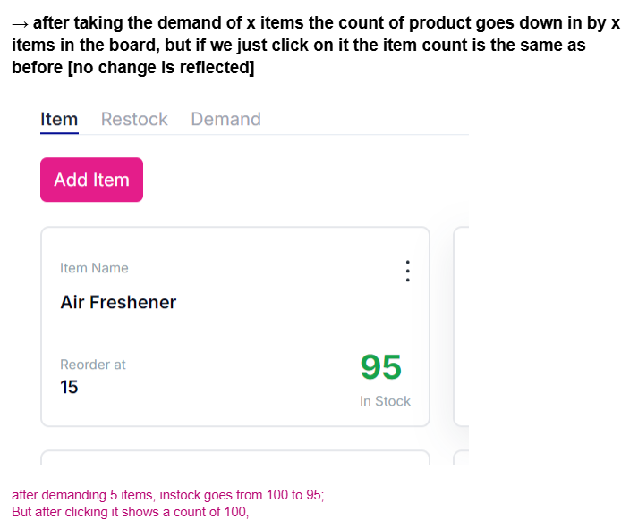
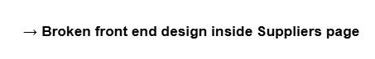
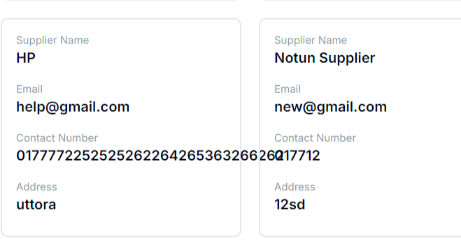
02. Project Contributions
My Contributions to other projects :
Testing on Quantanite project:
Manually tested Quantanite project and found bugs on order values and also gives report on how to reproduce
Figure: testing Quantanite project
Notes:
Subscription-service

Slide 18
02. Project Contributions
Overall Project Challenges
Integrating Stax payment gateway
Understanding stax flow for adding credit cards, activating subscriptions, generating invoice
The overall setup and flow of total ts360 project is quite complex [ it has many modules ]
understanding api gateway concepts
Notes:
Subscription-service

Slide 19
03. Future Prospects
Fields, I intend to explore in future:
AWS
DOCKER
Micro-services
CI/CD
Integration Testing
Time Estimation & Effort calculation
Notes:
Subscription-service

Slide 20
04. Overall Experience
My experience at NSL was both inspiring and rewarding. In short, if I were to highlight key aspects:
Supportive and enriching learning environment
Great experience with Scrum meetings
Excellent team collaboration and guidance
Opportunities for knowledge sharing
Chances to work with benchmark projects
Notes:
Subscription-service

Slide 21

Any Questions?

Slide 22
Thank You
info@neural-semiconductor.com

Slide 23
01. Learned Topics
Unit Testing
For testing my API apart from using Postman I also use Junit and Mockito
Learned how to test code
Introduced with Junit and Mockito framework
Annotations are important. For example:
@Test @After @Before @Mock @InjectMocks
Notes:
Dreyfus Model

Slide 24
SOLID
Design principles encourage us to create more maintainable, understandable, and flexible software.
Single Responsibility
Open/Closed Principle
Liskov Substitution Principle
Interface Segregation Principle
Dependency Inversion Principle

Slide 25
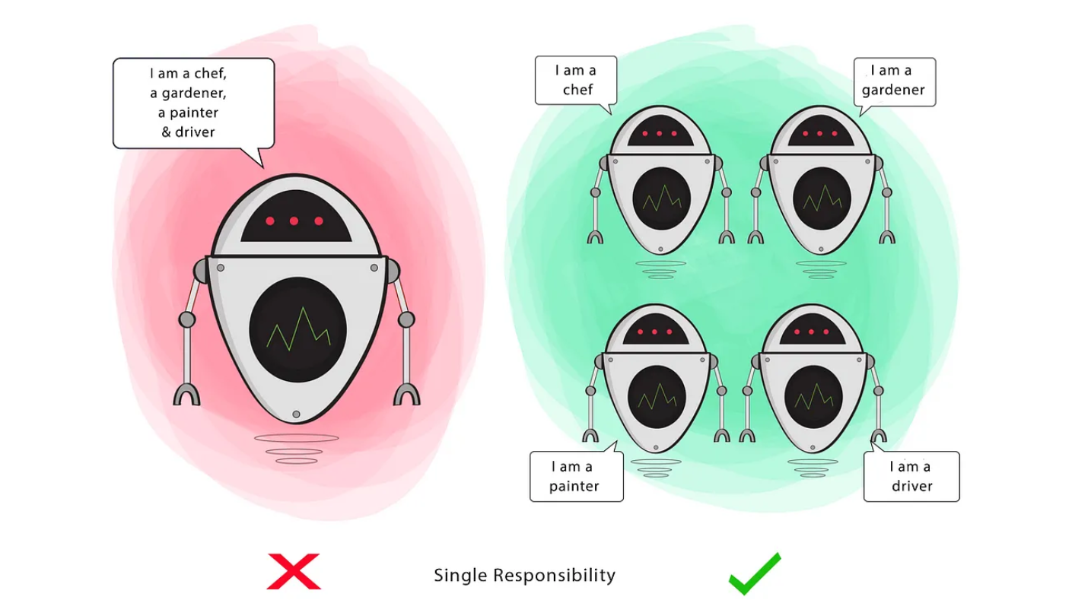
S = Single Responsibility Principle
Design principles encourage us to create more maintainable, understandable, and flexible software.

Slide 26
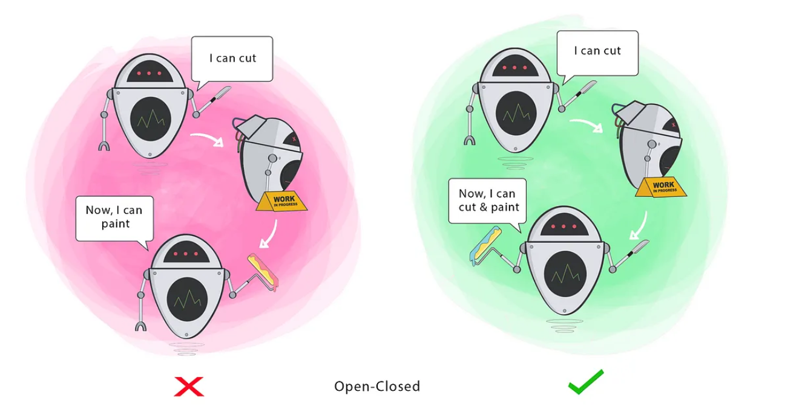
O = Open/Close Principle
Design principles encourage us to create more maintainable, understandable, and flexible software.

Slide 27
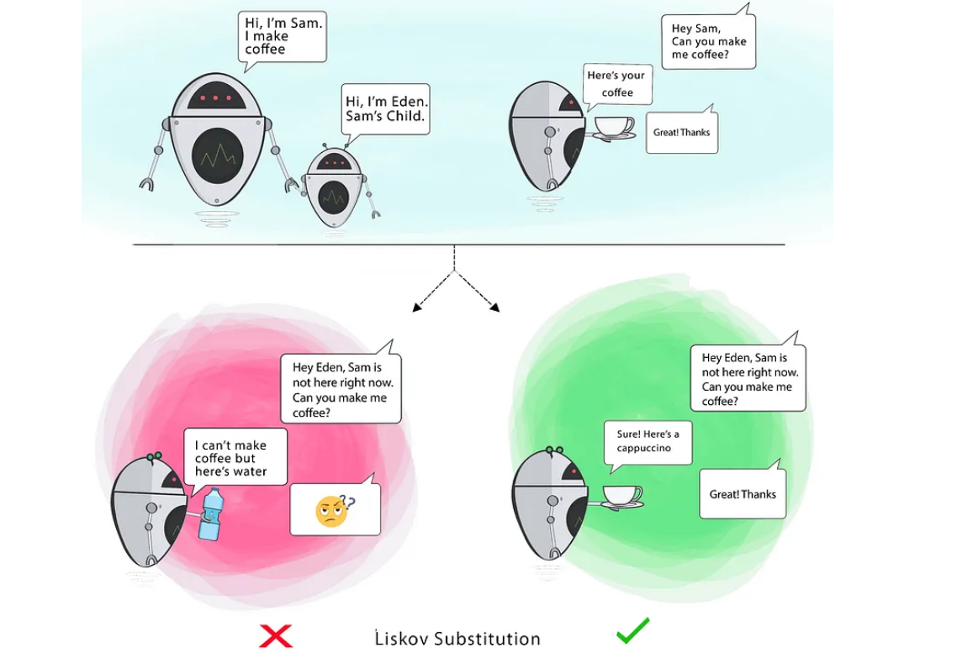
L = Liskov Inversion Principle
Design principles encourage us to create more maintainable, understandable, and flexible software.

Slide 28
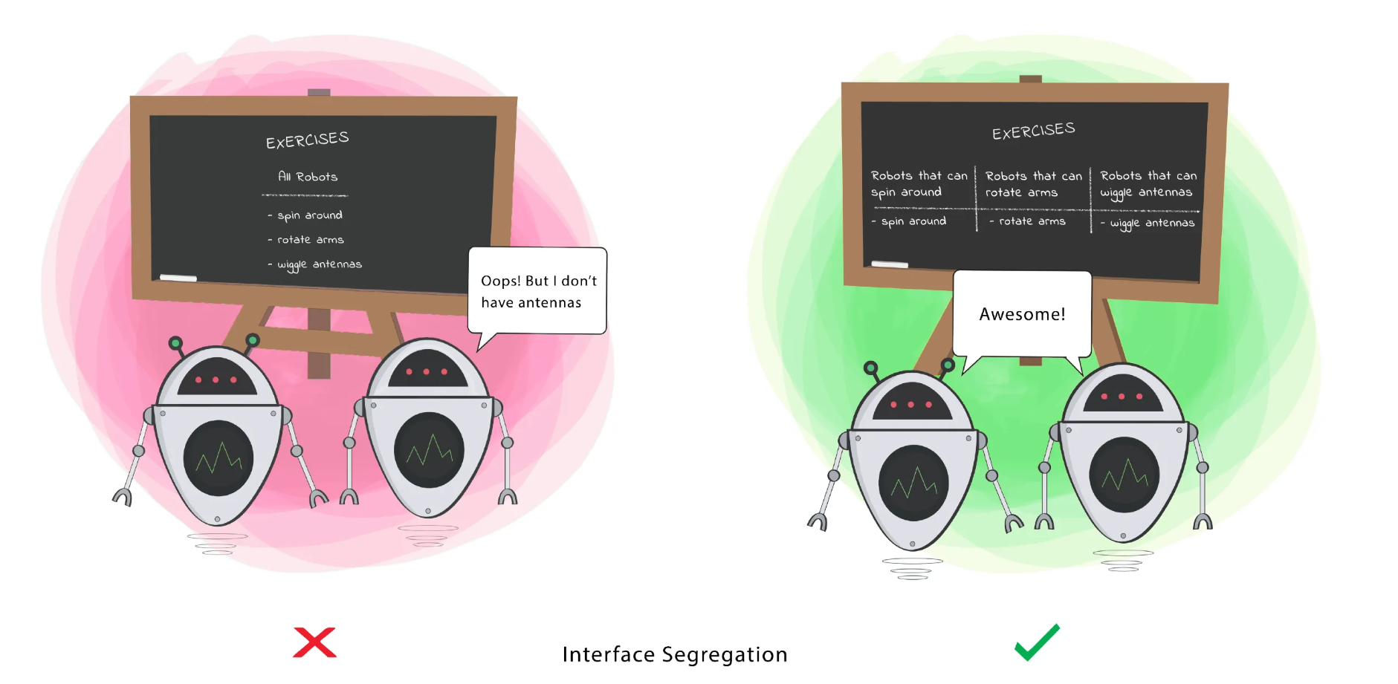
I = Interface Segregation Principle
Design principles encourage us to create more maintainable,understandable, and flexible software.

Slide 29
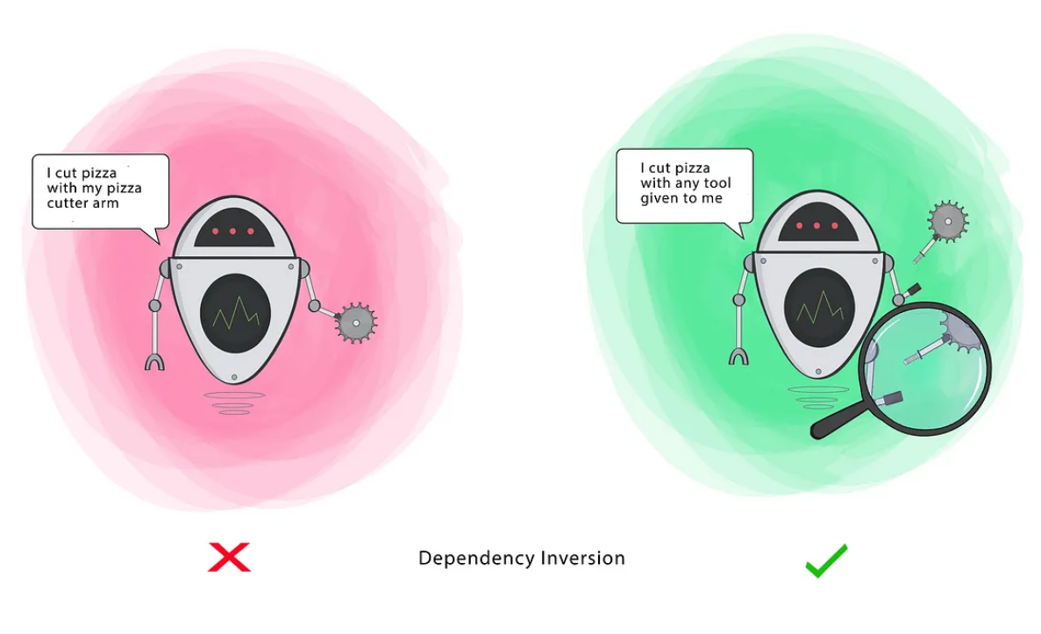
D = Dependency Inversion Principle
Design principles encourage us to create more maintainable,understandable, and flexible software.

Slide 30
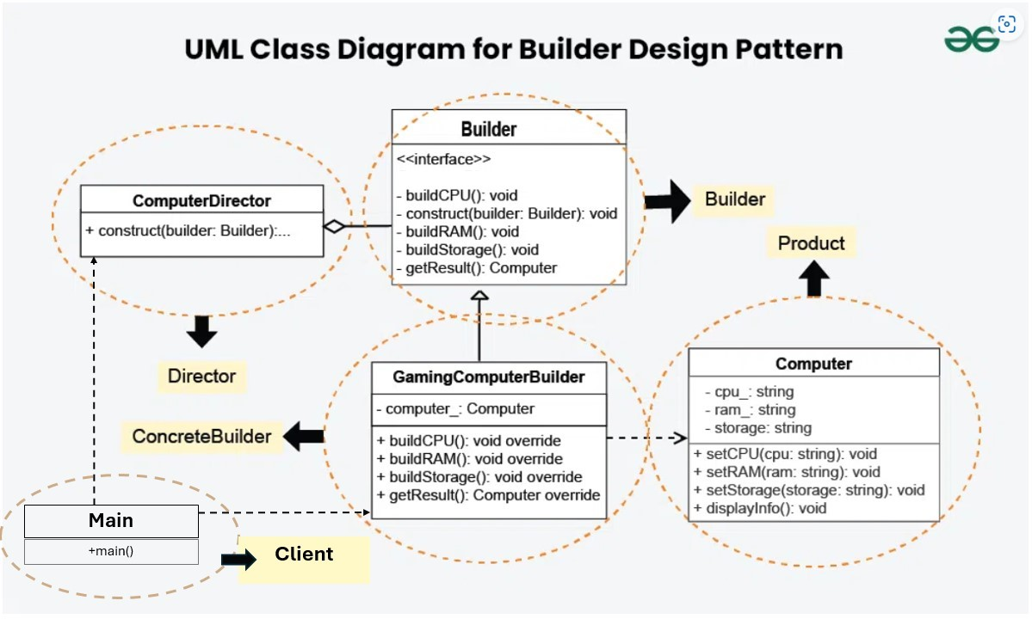
Design Pattern
Design patterns are general, reusable solutions to common problems that arise in software design.
Creational Patterns
a. Builder

Slide 31
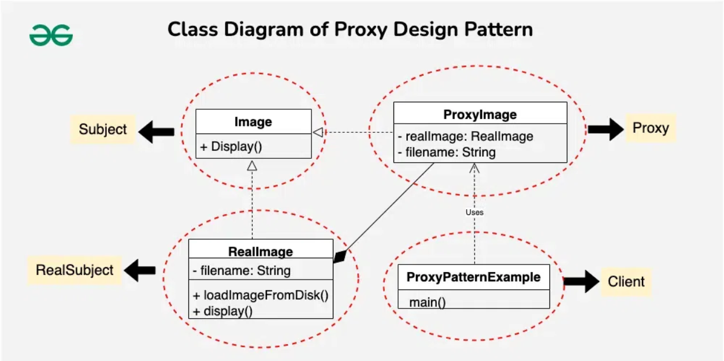
Design Pattern
Design patterns are general, reusable solutions to common problems that arise in software design.
Structural Patterns
a. Proxy

Slide 32
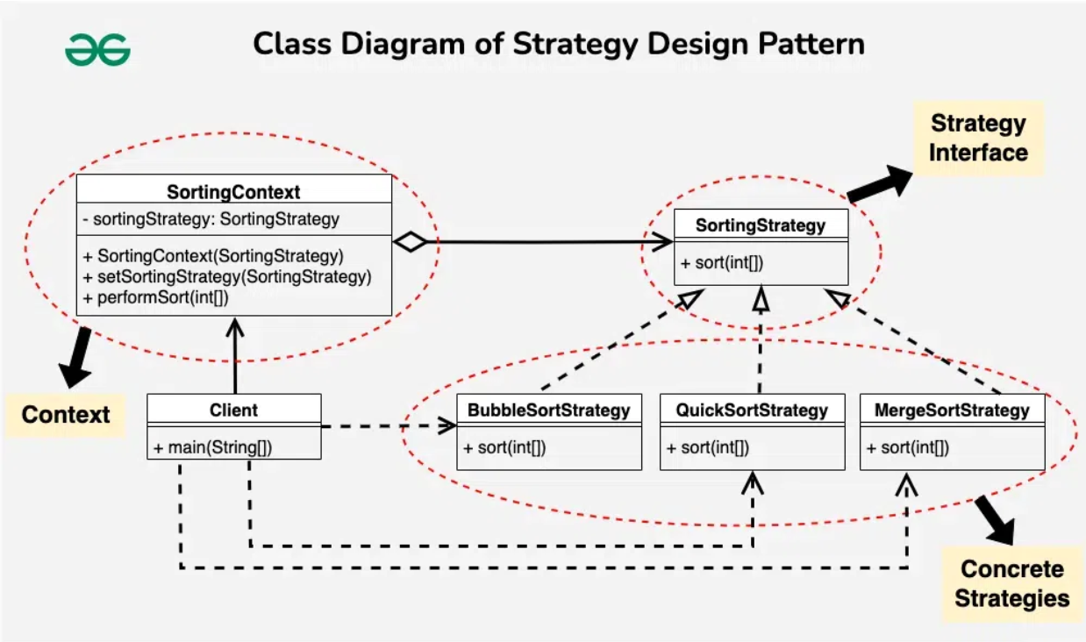
Design Pattern
Design patterns are general, reusable solutions to common problems that arise in software design.
Behavioral Patterns
a. Strategy

Slide 33
Database
DBMS keys:
Database Normalization
ACID properties

Slide 34
Restful Architecture

Slide 35
Testing with Mockito
Insert Anomaly :
certain attributes cannot be inserted into the database
without the presence of other attributes.
Delete Anomaly:
exists when certain attributes are lost
because of the deletion of other attributes.
Update Anomaly:
exists when changing of one instance of data,
requires changes on multiple places

Slide 36
Workflow
Insert Anomaly :
certain attributes cannot be inserted into the database
without the presence of other attributes.
Delete Anomaly:
exists when certain attributes are lost
because of the deletion of other attributes.
Update Anomaly:
exists when changing of one instance of data,
requires changes on multiple places

Slide 37
Testsprint360
Insert Anomaly :
certain attributes cannot be inserted into the database
without the presence of other attributes.
Delete Anomaly:
exists when certain attributes are lost
because of the deletion of other attributes.
Update Anomaly:
exists when changing of one instance of data,
requires changes on multiple places

